Slide 1

Team members
Supervisor : Fabrice RETIERE
Student : Carl RETHMEIER
Student : Paul LOPES GOEMS

Slide 2
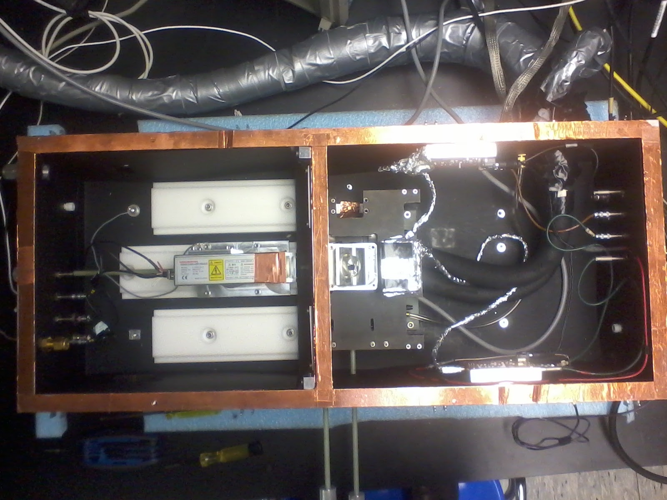
How does the setup work ?
cooling system
Amplifiers
MPPC bottom detector
N2 input
MPPC top detector
Xenon Flash lamp
N2 output

Slide 3
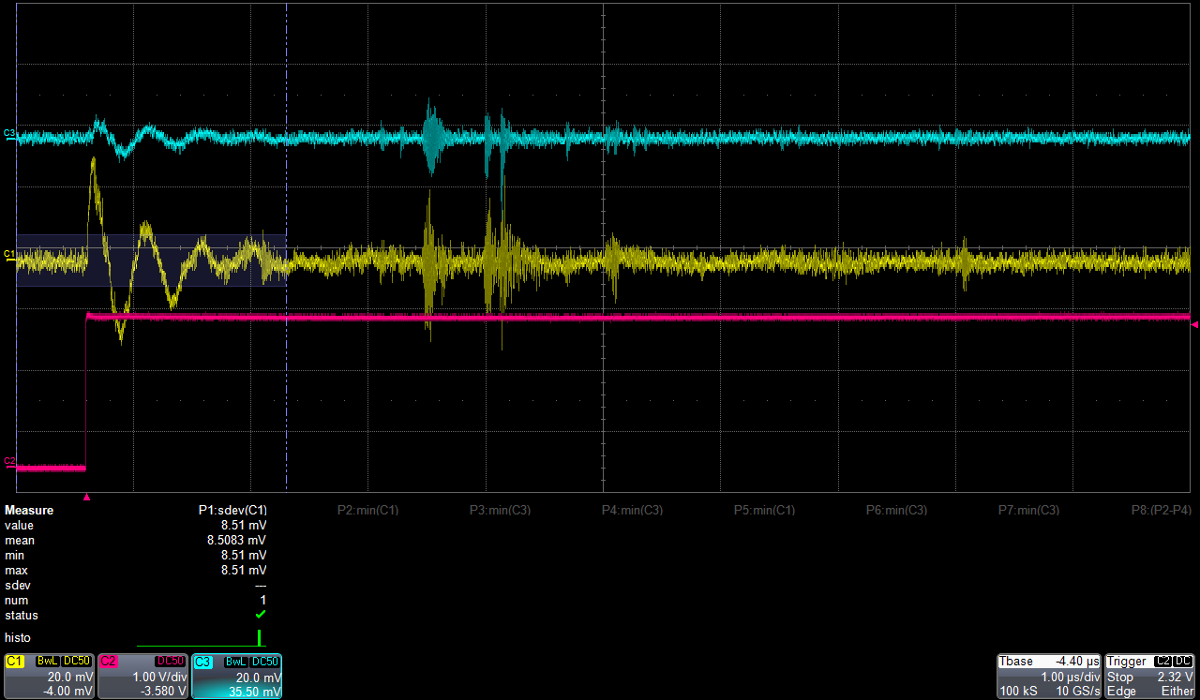
Reduce electronic noise to have better results
Too much electronic noise on the signal observed on the oscilloscope :
Sol. 1. : Could improve the code - WaveFormProcess -
Sol. 2. : Improve the setup

Slide 4
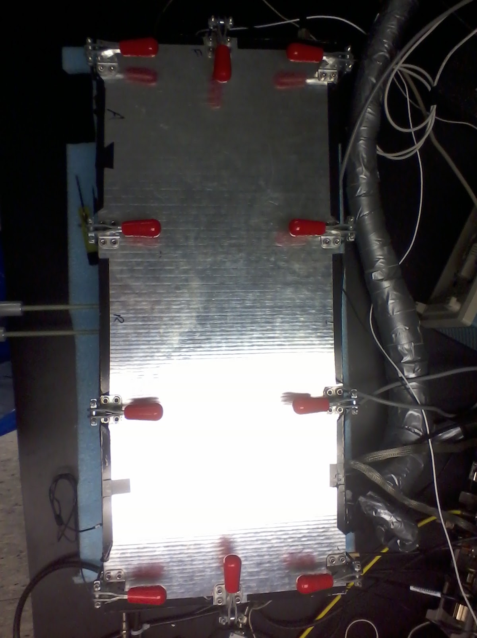
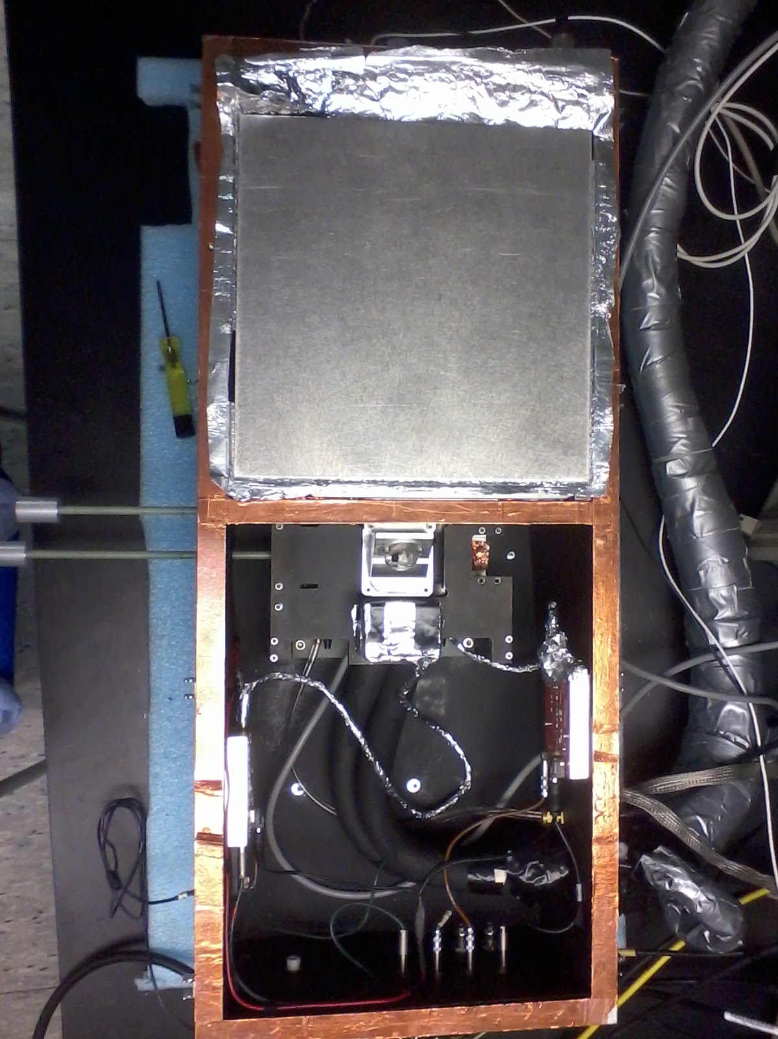
Sources of electronic noise
Ground loops and no ground point
When the F.L. is on it creates radio waves whose frequencies are between 400 MHz and 1.2 GHz
Radio waves propagate through the air and are transmitted to any piece of conductive metal
The lid of the box conduct electric field and disturb the amplifiers >> the signal is disturbed
Each detector receives these radio waves >> the signal is disturbed
The metal divider act as a transmitter and the connectors of the signal wire act as
antenna >> the signal is disturbed
metal divider
The lid of the box
Connectors to the amplifiers

Slide 5
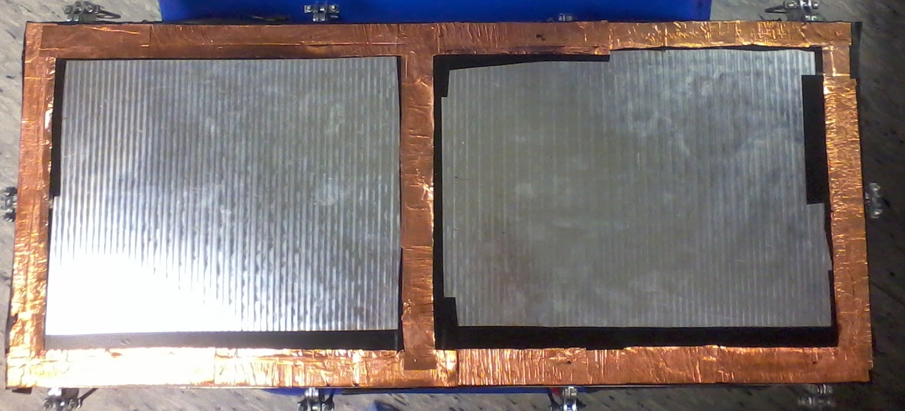
Three main solutions to improve the setup
Create a ground point : help for trigger.
Isolate the lid from the box.
Copper tape
Copper tape
Csq :
- The electric field from the flash lamp is guided by copper
- No more electric field above the amplifiers

Slide 6
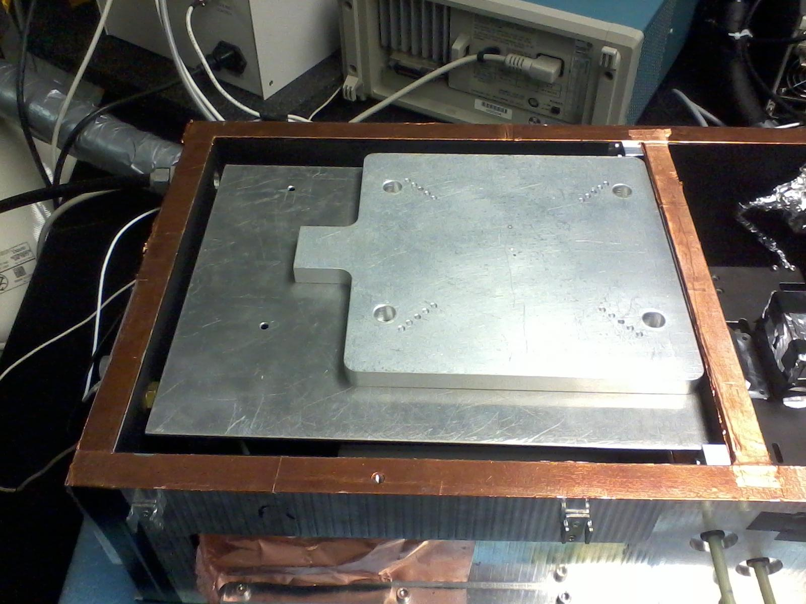
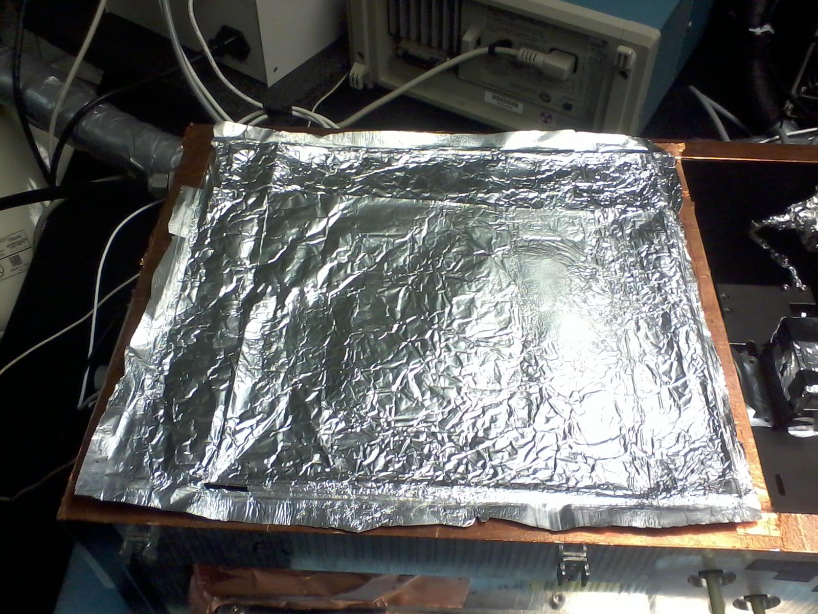
Three main solutions to improve the setup
Isolate the flash lamp : Faraday cage.
A aluminum foil, connected to the pieces of metal, conduct electric field to the copper tape and so to the ground.
The centimeter thick piece of metal absorb radio waves from the F.L.

Slide 7
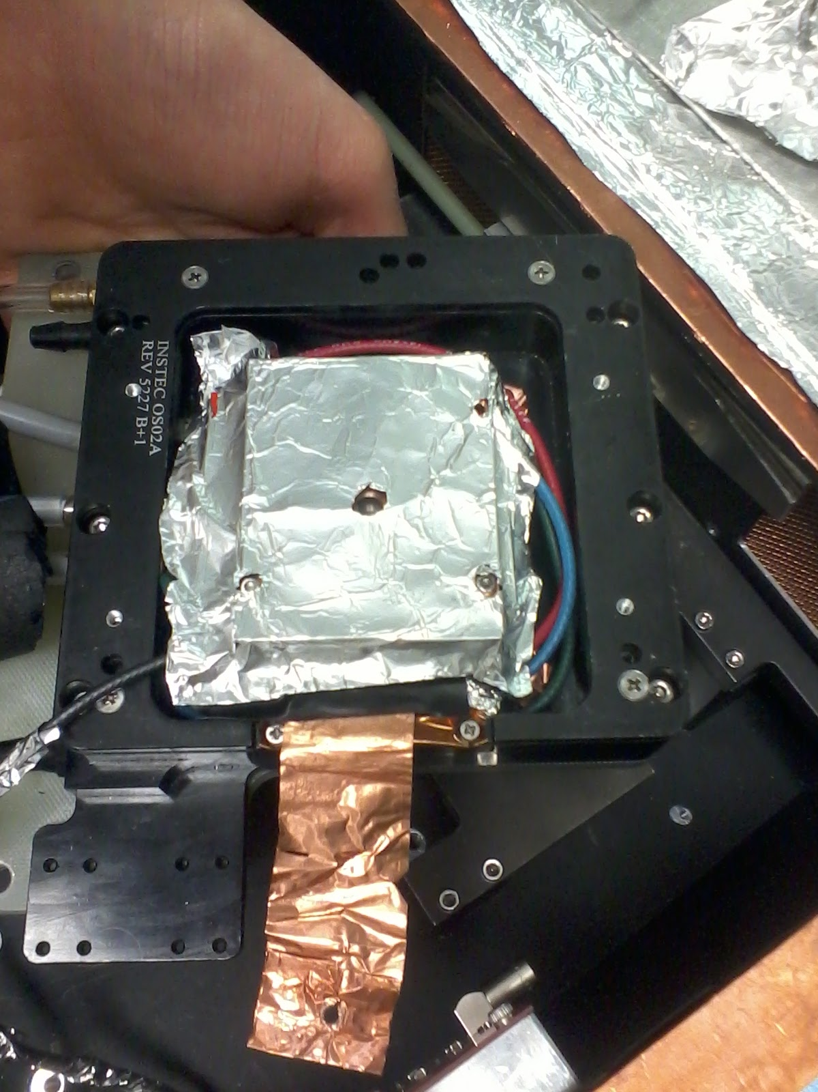
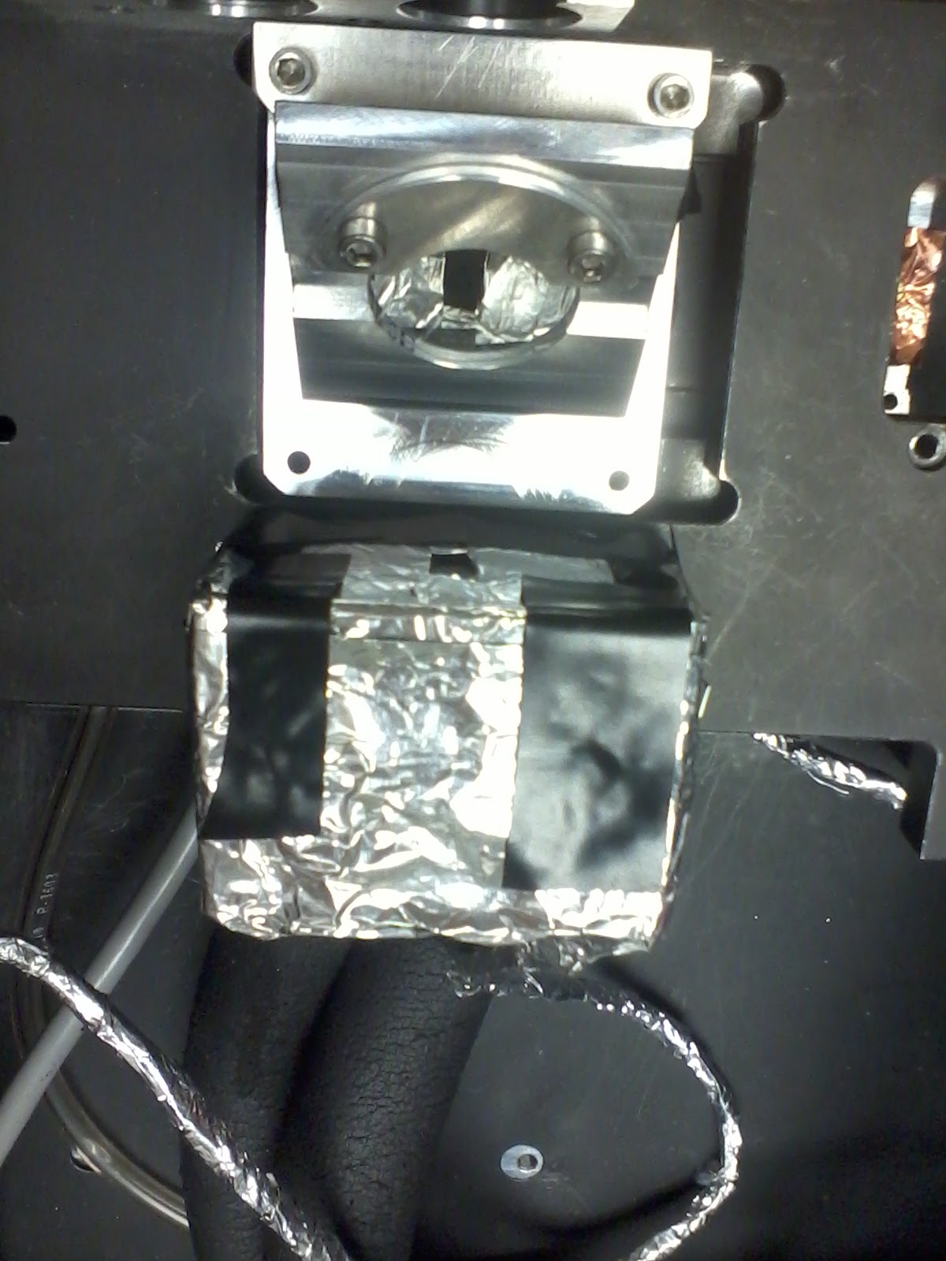
Three main solutions to improve the setup
Isolate the detectors from the radio waves of the F.L. : Faraday cage.
Aluminum foil
Signal
Hole for the light
Copper to ground (inside)
Signal
Copper to ground

Slide 8
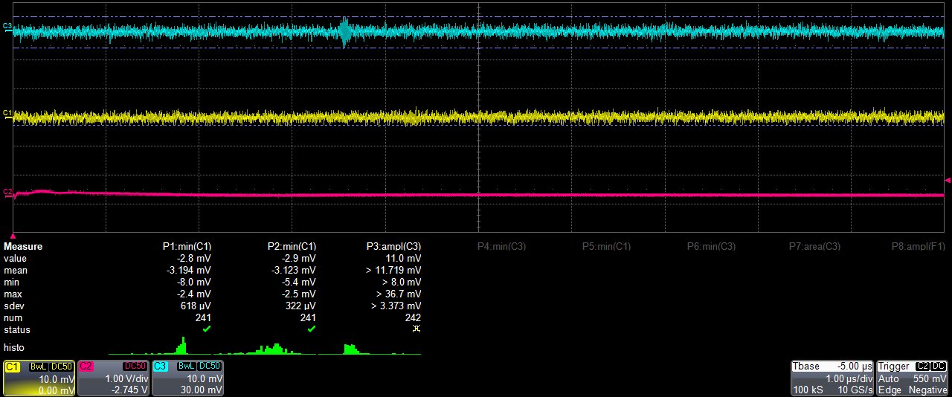
Both signals get better

